Slide 1
Cimenterie Report on Rings formation in kiln
Kiln Heavy Build Ups details

Slide 2
Kiln Operation Summary
Kiln First light up on 16th Nov
Nov – December operation was normal
Kiln Run (12Feb,17 ~ 27 Feb,17) stopped on Ring formation)
Kiln Run (16Mar,17 ~ 22 Mar,17) stopped on Ring formation)
Kiln Run (13Aug,17 ~ 20 Aug,17) stopped on Ring formation)
Kiln Run (22 Nov,17 ~ 05 Jan-18) stopped on Ring formation)

Slide 3
Kiln normal Operation chemistry
Date: | Kiln Feed |  |  | Clinker
 | LSF | SM | AM | LSF | SM | AM | LQ 1450
7-Dec-16 | 102.78 | 2.32 | 1.51 | 92.57 | 2.46 | 1.59 | 27.57
8-Dec-16 | 102.89 | 2.32 | 1.48 | 92.43 | 2.47 | 1.55 | 27.41
9-Dec-16 | 102.59 | 2.33 | 1.50 | 92.75 | 2.47 | 1.56 | 27.15
10-Dec-16 | 102.61 | 2.34 | 1.50 | 91.91 | 2.42 | 1.62 | 27.79
11-Dec-16 | 104.00 | 2.33 | 1.50 | 92.75 | 2.46 | 1.60 | 27.31
12-Dec-16 | 104.52 | 2.35 | 1.56 | 92.04 | 2.47 | 1.68 | 27.59
16-Dec-16 | 101.10 | 2.34 | 1.53 | 90.72 | 2.46 | 1.63 | 27.78
17-Dec-16 | 100.75 | 2.36 | 1.52 | 90.46 | 2.45 | 1.66 | 28.06
18-Dec-16 | 101.60 | 2.32 | 1.53 | 90.47 | 2.46 | 1.63 | 28.36
29-Dec-16 | 100.33 | 2.33 | 1.48 | 90.21 | 2.47 | 1.58 | 28.32
30-Dec-16 | 99.01 | 2.36 | 1.49 | 89.22 | 2.43 | 1.62 | 28.97
31-Dec-16 | 96.75 | 2.40 | 1.55 | 86.50 | 2.49 | 1.68 | 29.045
Average | 101.20 | 2.33 | 1.50 | 90.90 | 2.44 | 1.61 | 28.12
STD | 1.28 | 0.03 | 0.04 | 1.21 | 0.05 | 0.05 | 0.49

Slide 4
Kiln commercial Operation chemistry
Date: | Kiln Feed Analysis |  |  | Clinker Analysis
 | LSF | SM | AM | LSF | SM | AM | L.Ph1450 | Lwt
2/14/2017 | 99.07 | 2.34 | 1.57 | 92.97 | 2.30 | 1.61 | 28.78 | 1300.63
2/15/2017 | 100.64 | 2.32 | 1.53 | 93.69 | 2.28 | 1.56 | 28.78 | 1286.04
2/16/2017 | 100.38 | 2.34 | 1.51 | 93.89 | 2.28 | 1.55 | 28.70 | 1296.14
2/17/2017 | 99.69 | 2.33 | 1.52 | 93.75 | 2.28 | 1.58 | 28.69 | 1333.06
2/18/2017 | 98.34 | 2.32 | 1.50 | 93.00 | 2.24 | 1.55 | 29.17 | 1304.58
2/19/2017 | 99.79 | 2.32 | 1.49 | 93.05 | 2.25 | 1.51 | 29.01 | 1241.88
2/20/2017 | 100.18 | 2.32 | 1.50 | 94.04 | 2.29 | 1.53 | 28.55 | 1296.58
2/21/2017 | 99.85 | 2.31 | 1.51 | 93.52 | 2.25 | 1.53 | 29.12 | 1303.41
2/22/2017 | 101.71 | 2.39 | 1.56 | 94.42 | 2.33 | 1.62 | 28.33 | 1278.04
2/23/2017 | 101.56 | 2.34 | 1.57 | 94.10 | 2.31 | 1.57 | 28.56 | 1294.29
2/24/2017 | 101.01 | 2.34 | 1.57 | 93.61 | 2.29 | 1.61 | 28.82 | 1253.75
Average: | 100.20 | 2.33 | 1.53 | 93.64 | 2.28 | 1.57 | 28.77 | 1290
STD | 1.014533 | 0.022 | 0.03 | 0.48 | 0.027 | 0.04 | 0.2528 | 24.994

Slide 5
Chemistry During Ist Stoppage (Ring formation material leakage from inlet)
Date: | Kiln Feed Analysis |  |  | Clinker Analysis
 | LSF | SM | AM | LSF | SM | AM | L.Ph1450 | Lt.wt
2/25/2017 | 101.64 | 2.37 | 1.60 | 94.52 | 2.34 | 1.64 | 28.40 | 1291
2/26/2017 | 102.81 | 2.37 | 1.62 | 94.94 | 2.34 | 1.65 | 28.34 | 1283
2/27/2017 | 103.45 | 2.38 | 1.62 | 95.11 | 2.34 | 1.67 | 28.33 | 1259
Avg: | 102.63 | 2.37 | 1.61 | 94.86 | 2.34 | 1.65 | 28.36 | 1278

Slide 6
Chemistry of Ring at different area chemical composition
S # | Date | Sample ID | Chemical Composition
 |  |  | SiO₂ | AI₂O₃ | Fe₂O₃ | CaO | MgO | SO₃ | K₂O | Na₂O | LOI | Free Lime | Total
 |  |  | % | % | % | % | % | % | % | % | % | %
1 | 2-Mar-17 | Kiln Coating 21 Meters | 21.61 | 6.20 | 3.65 | 64.46 | 2.04 | 0.96 | 0.79 | 0.32 | 0.40 | 1.38 | 100.43
2 | 2-Mar-17 | Kiln Coating 25 Meters | 21.60 | 6.21 | 3.58 | 63.47 | 2.00 | 1.47 | 1.08 | 0.36 | 0.38 | 4.17 | 100.15
3 | 2-Mar-17 | Clinker Dust at 21 Meters | 21.63 | 5.79 | 3.36 | 64.34 | 2.08 | 1.13 | 1.05 | 0.31 | 0.82 | 10.56 | 100.51
4 | 3-Mar-17 | Kiln Coating-1 27 Meters | 21.19 | 6.96 | 3.78 | 60.21 | 3.26 | 1.68 | 1.14 | 0.45 | 1.40 | 2.63 | 100.07
5 | 3-Mar-17 | Kiln Coating-2 27 Meters | 20.43 | 6.32 | 4.14 | 58.37 | 10.33 | 2.06 | 1.13 | 0.45 | 1.17 | 3.07 | 104.40
Average |  |  | 21.29 | 6.30 | 3.70 | 62.17 | 3.94 | 1.46 | 1.04 | 0.38 | 0.83 | 4.36 | 101.11
Max |  |  | 21.63 | 6.96 | 4.14 | 64.46 | 10.33 | 2.06 | 1.14 | 0.45 | 1.40 | 10.56 | 104.40
Min |  |  | 20.43 | 5.79 | 3.36 | 58.37 | 2.00 | 0.96 | 0.79 | 0.31 | 0.38 | 1.38 | 100.07
Stdev |  |  | 0.52 | 0.42 | 0.29 | 2.74 | 3.61 | 0.44 | 0.14 | 0.07 | 0.45 | 3.61 | 1.85

Slide 7
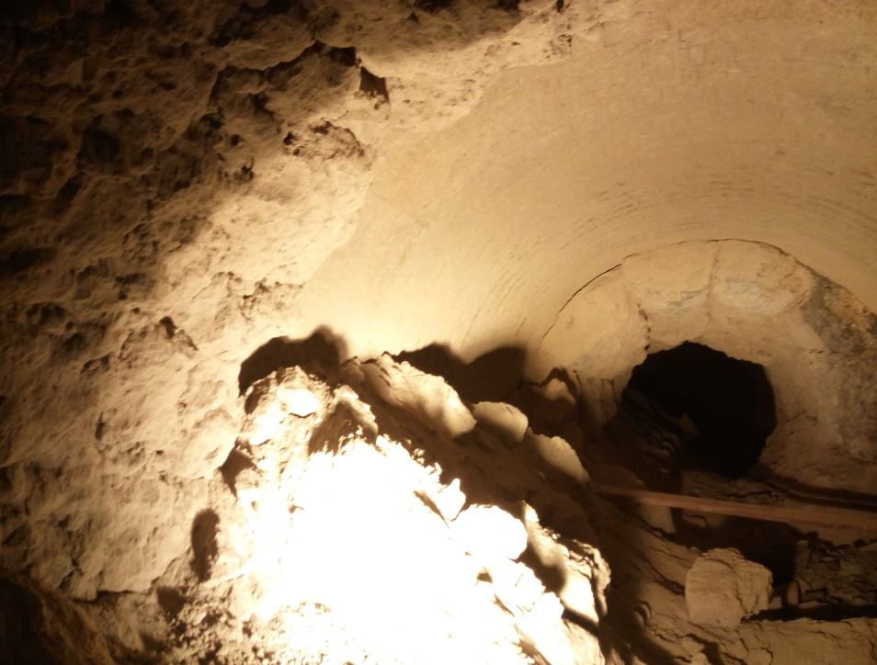
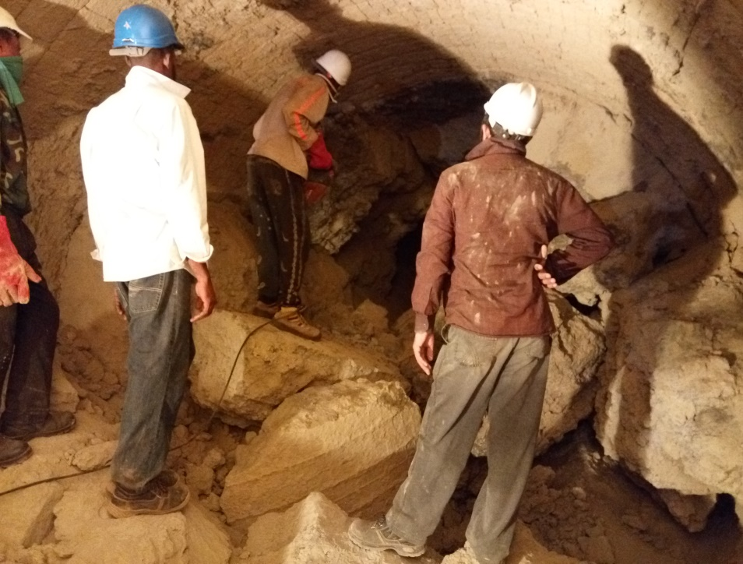
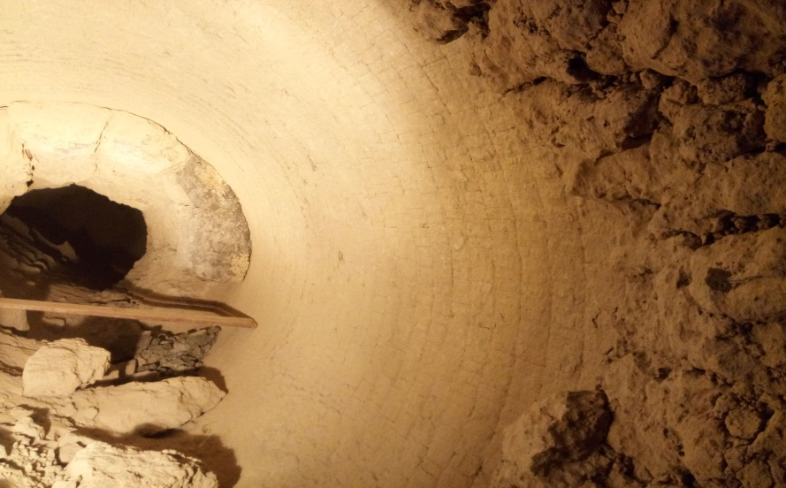
Some picture of inside kiln Ring(22~27M)
Coating thickness = 0.8~1m
Demolishing Ring
Hard coating thickness was 0.8~1m and take more time to cleaned all coating approximately 120 hours complete job
Coating =0.8m

Slide 8
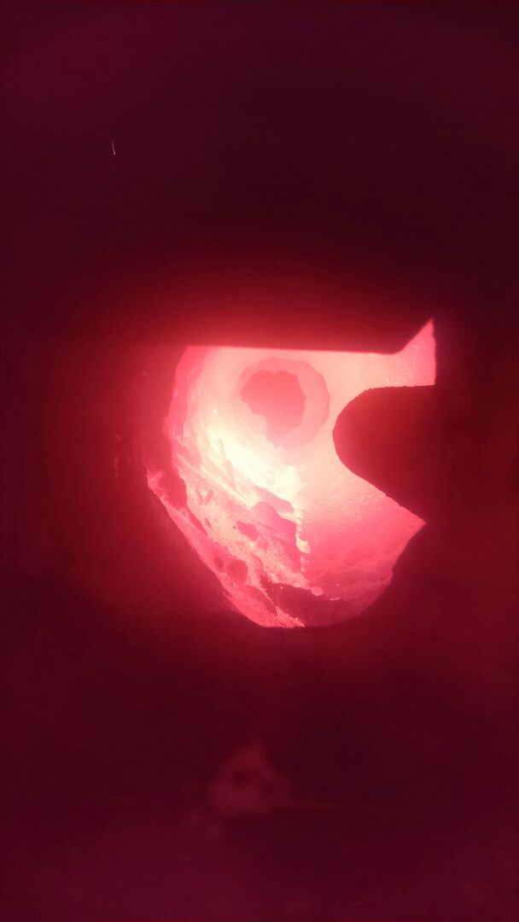
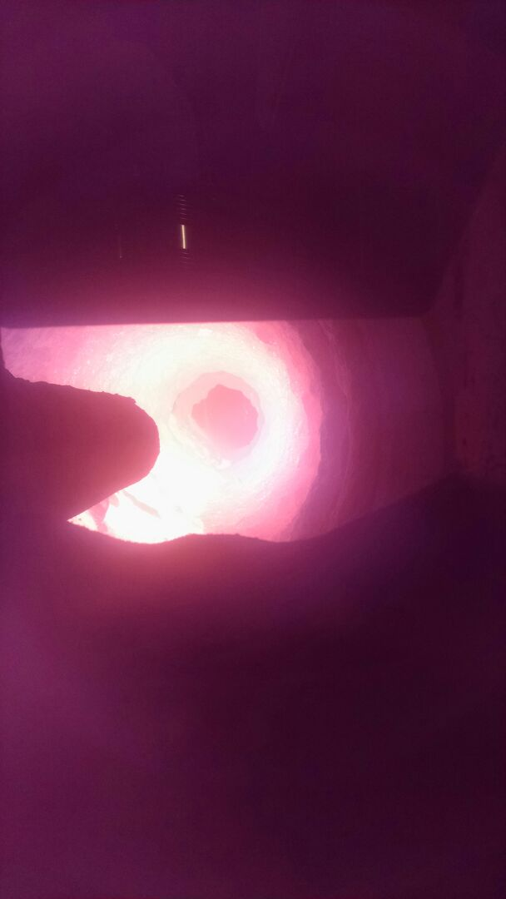
Ring Formation 17~26m material leakage from inlet seal

Slide 9
Chemistry of kiln inside ring (chemical composition)
Date : 25/3/2017 | Kiln inside Coating Chemical Composition
Sample ID | SiO₂ | Al₂O₃ | Fe₂O₃ | CaO | MgO | SO₃ | K₂O | Na₂O
COATING 23 METER | 22.30 | 5.75 | 2.91 | 63.33 | 2.12 | 0.89 | 0.97 | 0.36
COATING 24 METER | 22.94 | 5.68 | 2.93 | 64.46 | 2.04 | 0.85 | 0.72 | 0.34
COATING 25 METER | 21.40 | 5.89 | 2.94 | 63.04 | 2.19 | 0.89 | 0.85 | 0.34
COATING 27 METER | 20.52 | 5.71 | 2.77 | 63.17 | 2.14 | 1.00 | 1.01 | 0.32
COATING 28 METER | 20.66 | 5.62 | 2.79 | 66.14 | 2.36 | 0.95 | 0.79 | 0.31
AVERAGE | 21.56 | 5.73 | 2.87 | 64.03 | 2.17 | 0.92 | 0.87 | 0.33

Slide 10
AUGUST STOPPAGE
It Was 7 days operation , Coal was used during initial preheating and kiln stopped, Venturi found at 21m.
After this stoppage we reduced coal feeding during pre-heating.(coal introduction before 4~ 6 hrs. of feed).

Slide 11
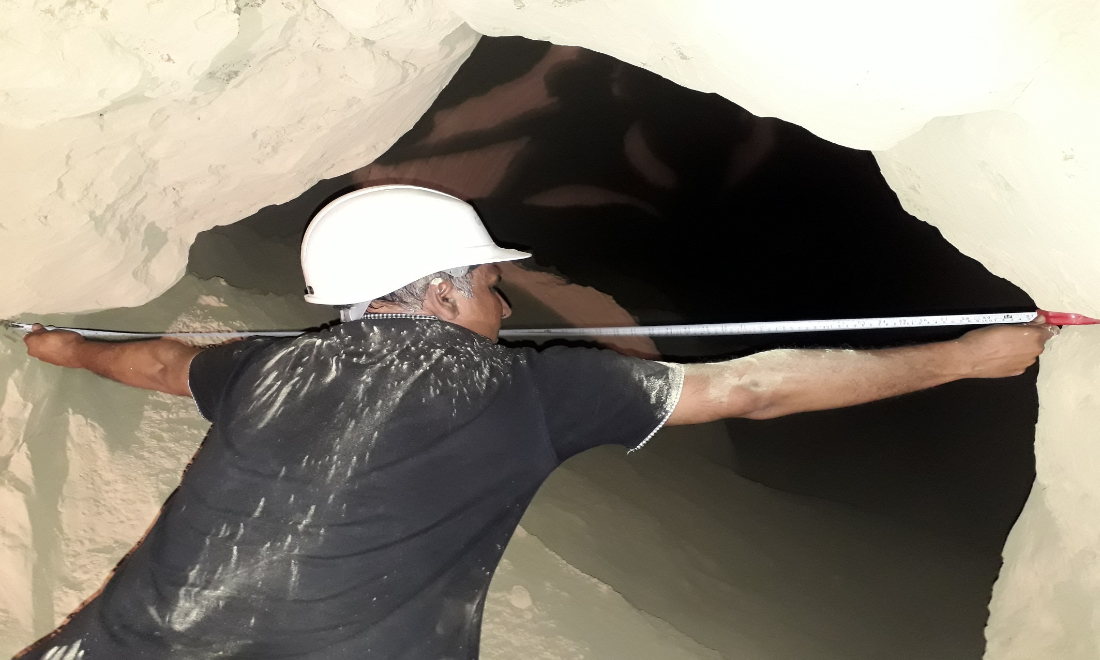
Coating at 19 m due to venturi(1600mm free area) formation

Slide 12
Steps taken to demolish ring
Main burner setting changing from 15~30mm
Primary air pressure kept in between 185~200mbar
Axial air position change from 50~100 interval of 2 hours
Radial air position change from 25~50 interval of 2hours.
Sand feeding continue through kiln feed screw conveyor.

